Slide 1
Bug Report ppt Naykaa
Name: Pranav Suryawanshi
student code:ft38_538

Slide 2
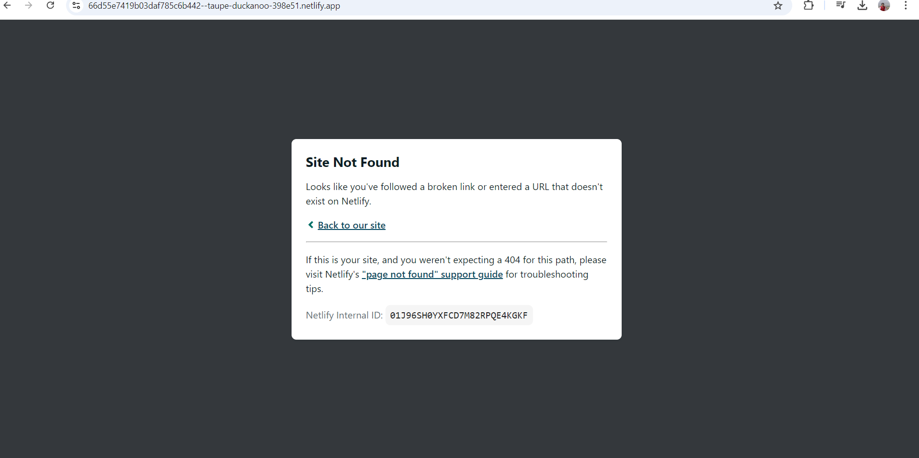
Bug_00: invalid URL is cannot handle

Slide 3
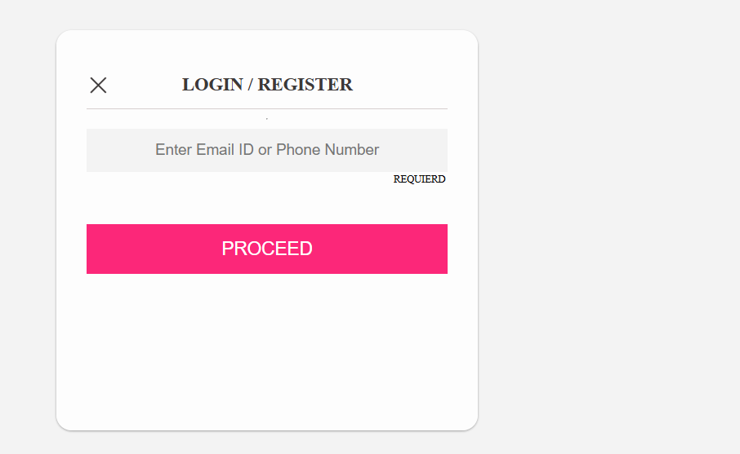
Bug_01:-Asterisk is not present in required field

Slide 4
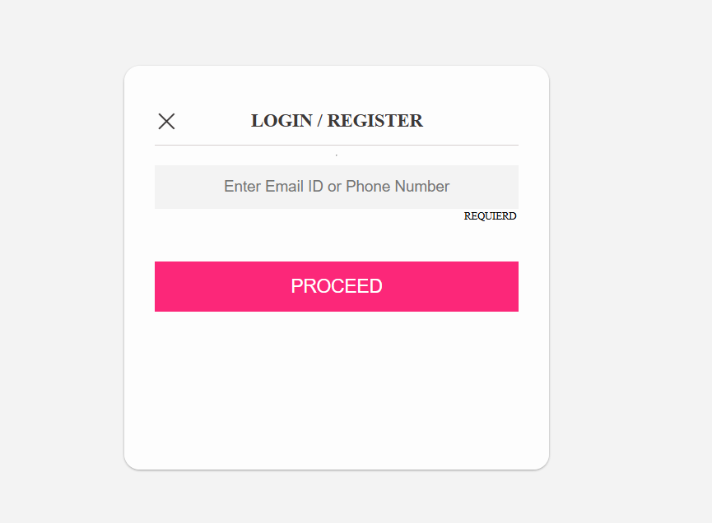
Bug_02 :-Continue button enabled without enter data

Slide 5
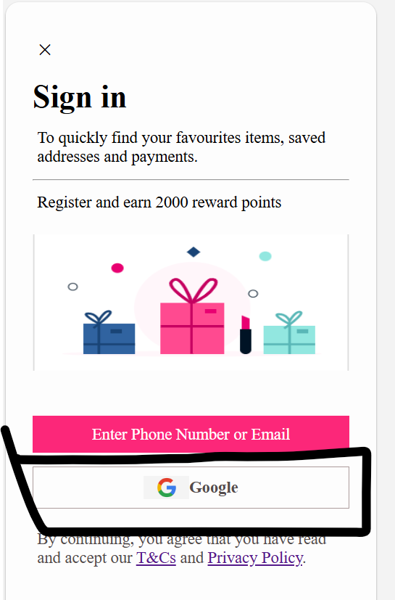
Bug_03 :-Sign-Up with social media link is not working

Slide 6
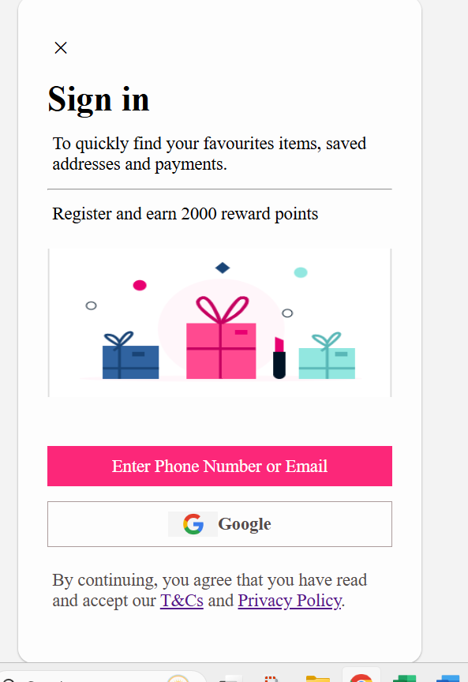
Bug_04:-T&C, Privacy and policy is not showing instruction

Slide 7
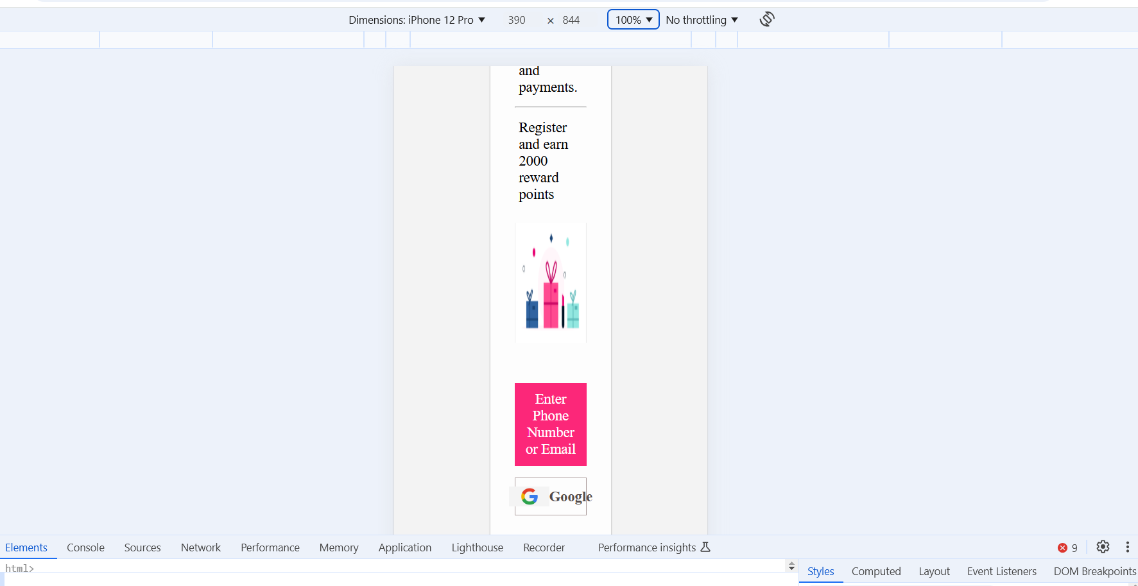
Bug_06:sigin/signup page is not responsive on different screen

Slide 8
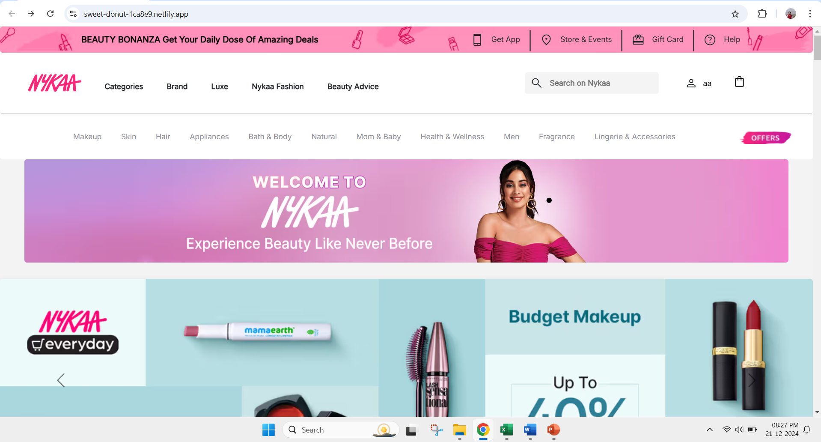
Bug_06:URL is not secure

Slide 9
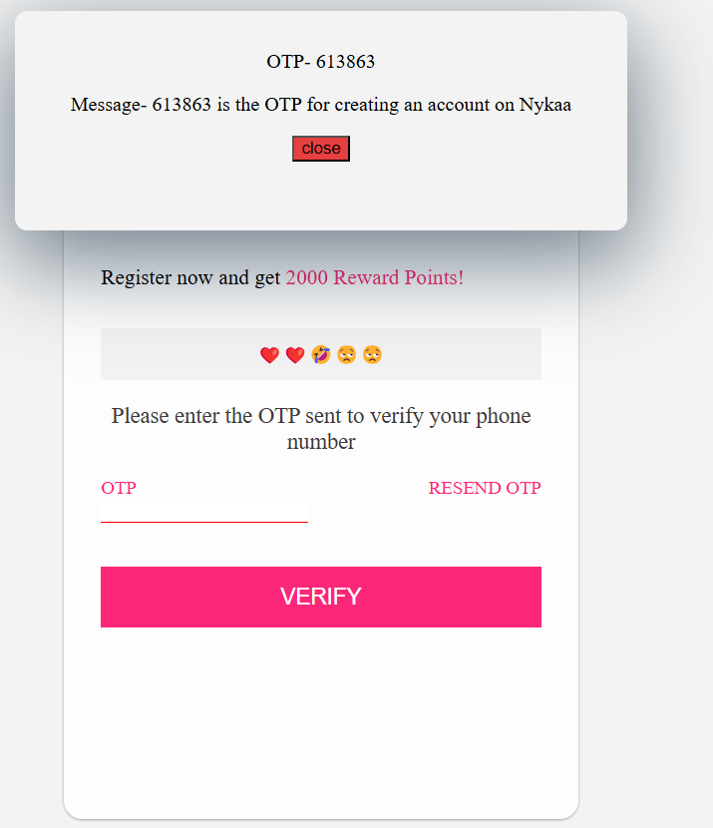
Bug_07:signup/login wit emoji

Slide 10
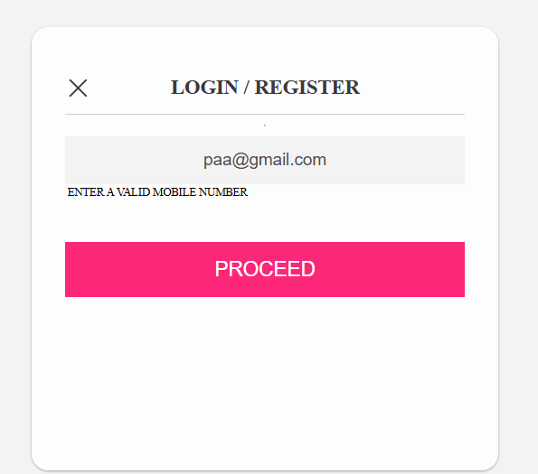
Bug_08: email id does not accept

Slide 11
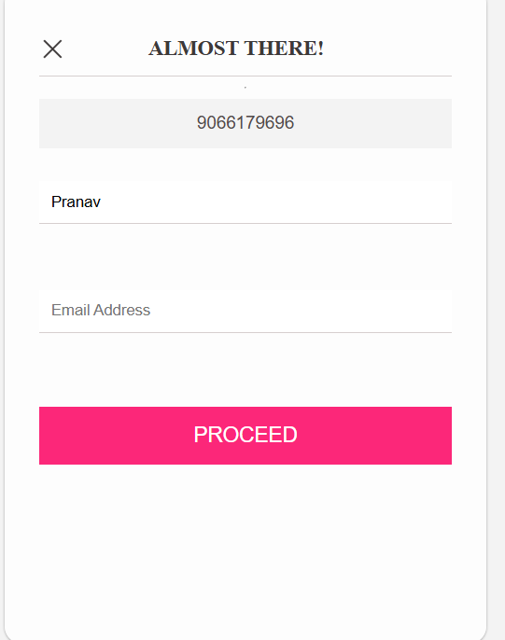
Bug_09:Signup without email id

Slide 12
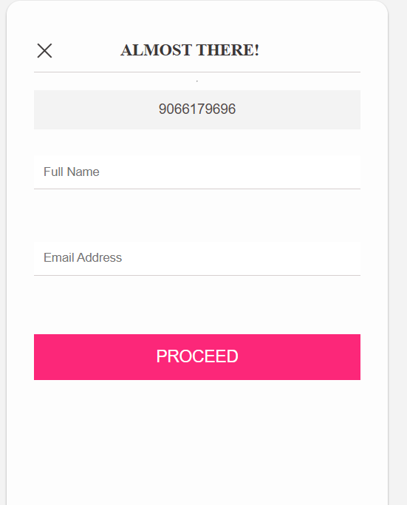
Bug_10:User is without entering data is signup

Slide 13
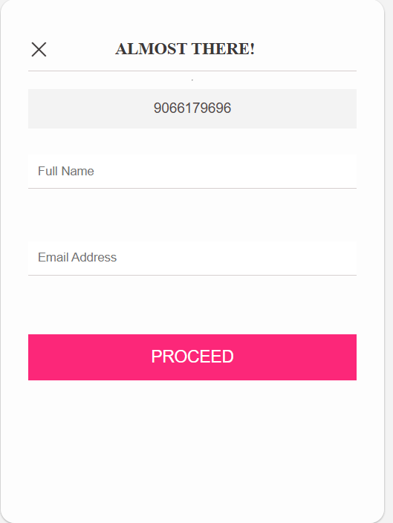
Bug_11:Asterik is not presnt in required filed

Slide 14
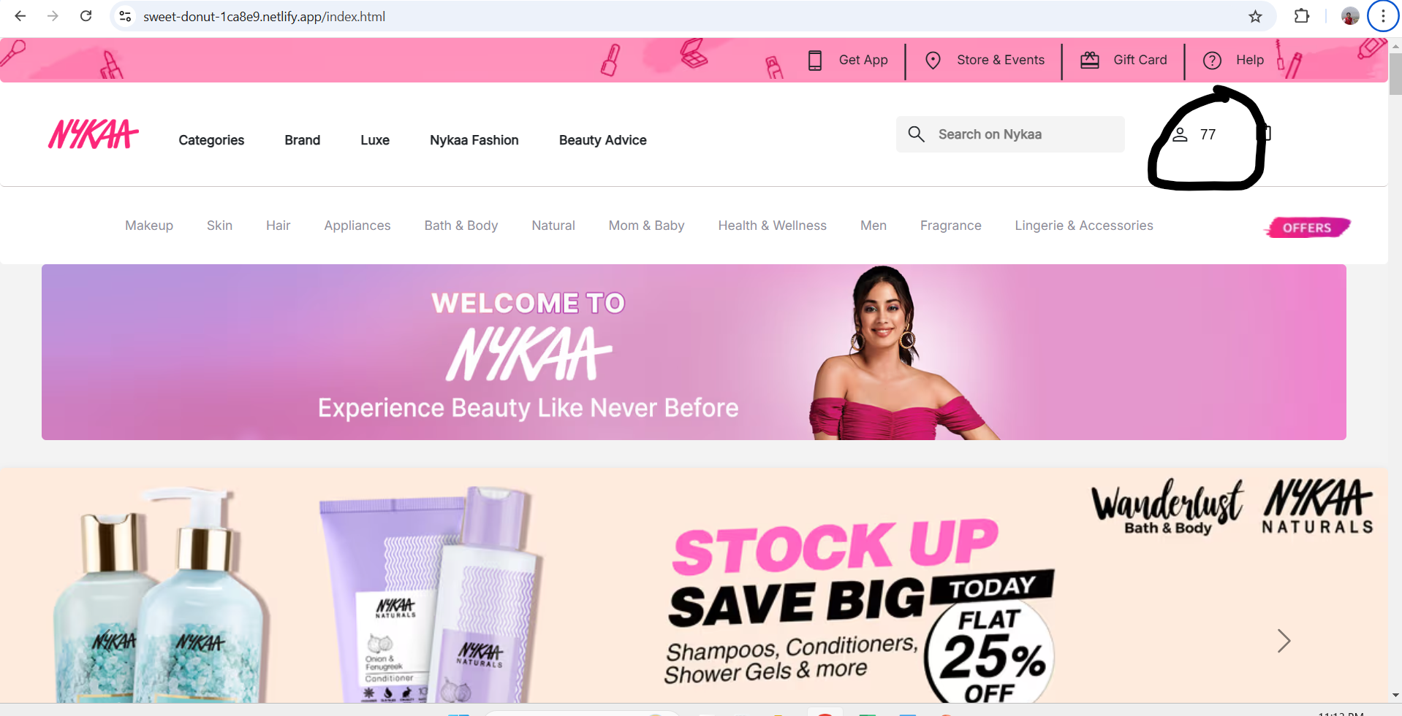
Bug_12:Sign-up with Integrer

Slide 15
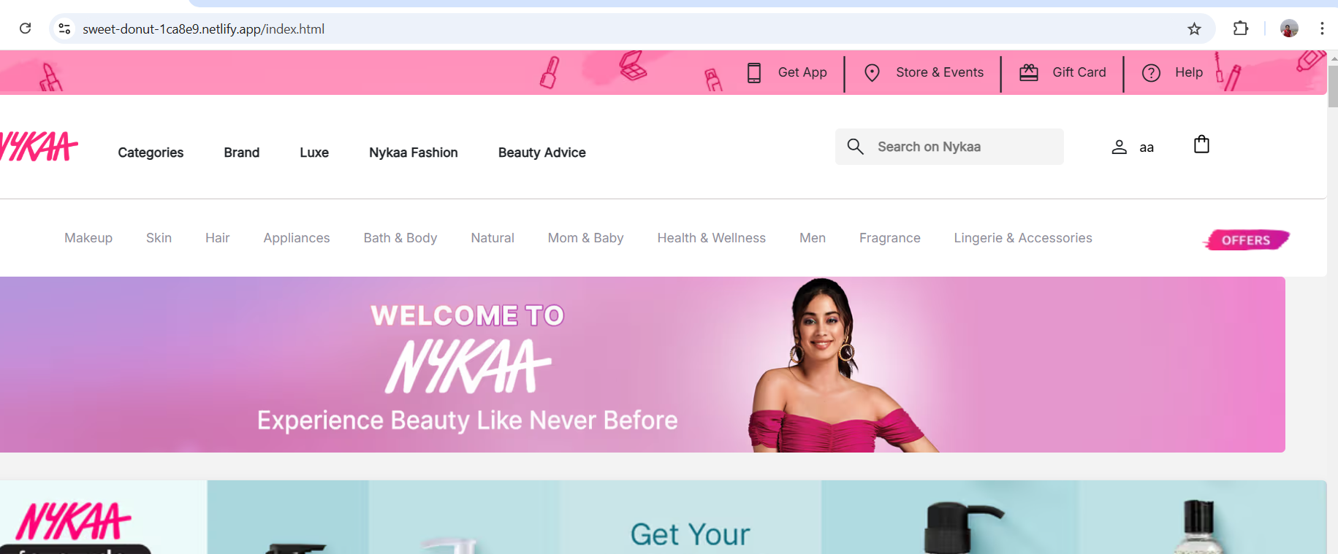
Bug_13:Signup with already register phone number

Slide 16
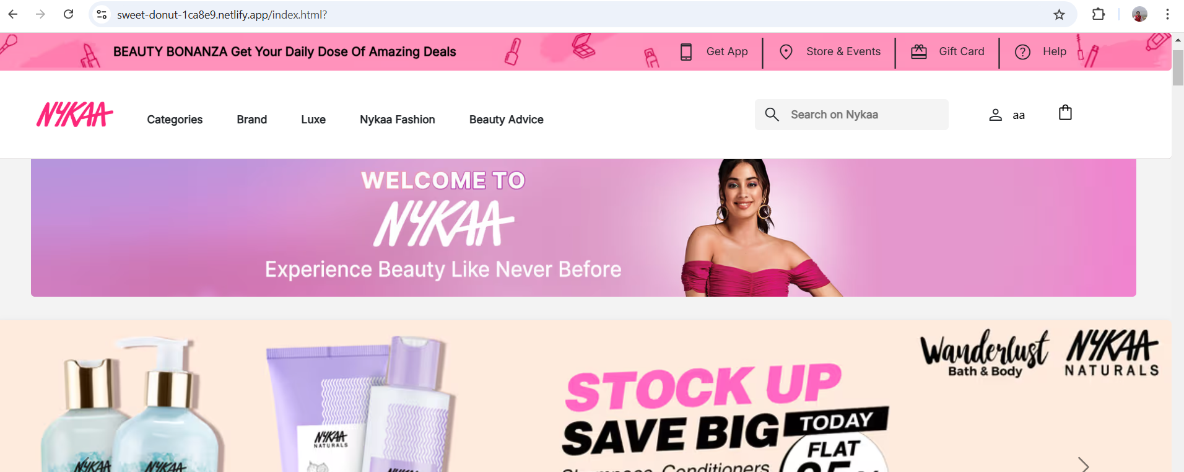
Bug_15:User is unable to logout

Slide 17
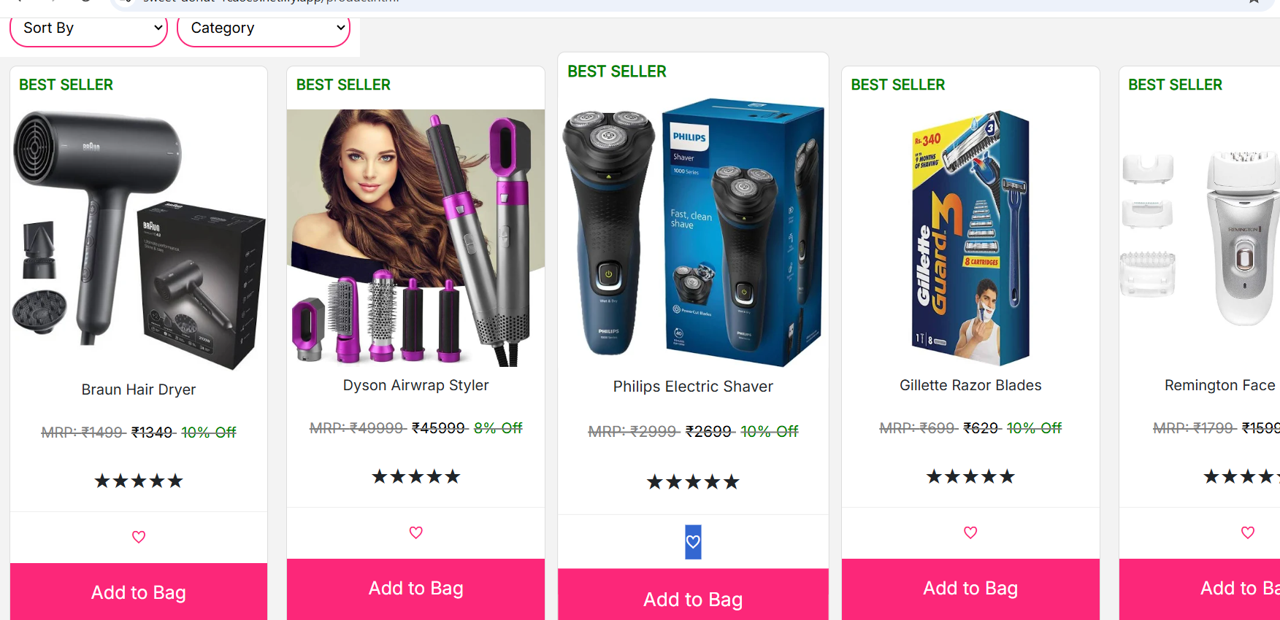
Bug_16:unable to add prduct in wishlist

Slide 18
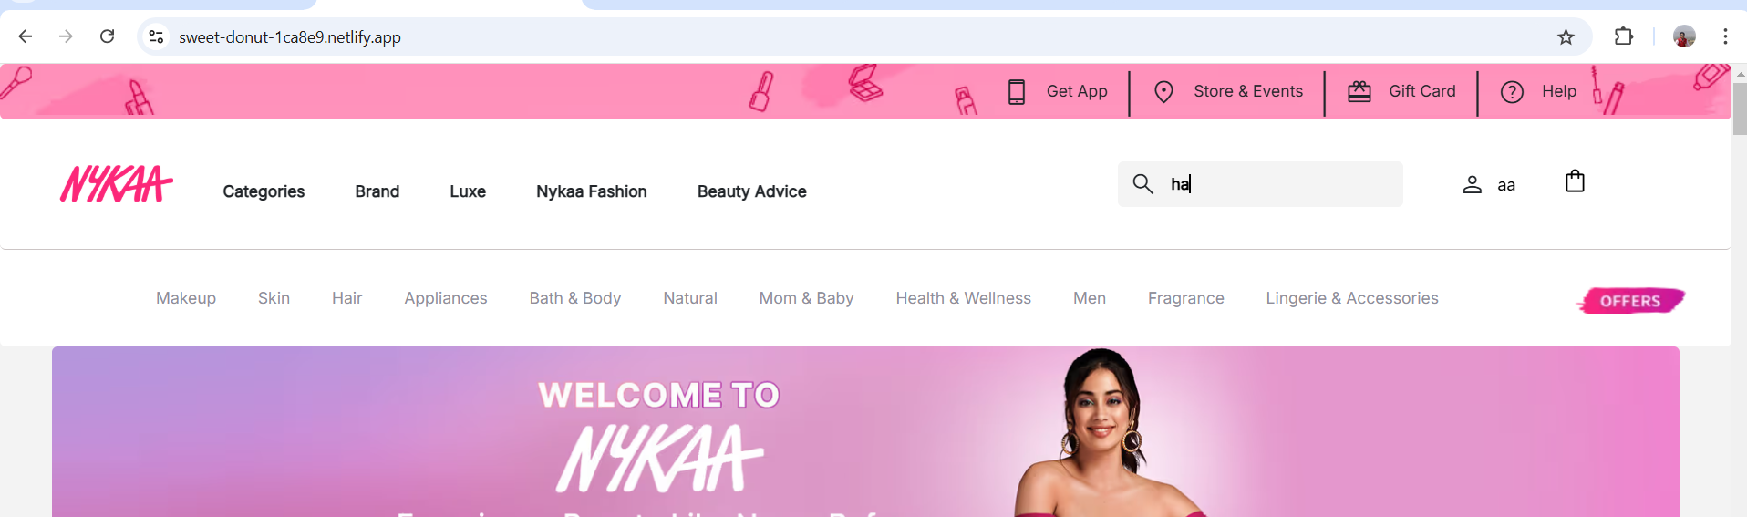
Bug_17: in search bar Autocomplete is not displayed

Slide 19
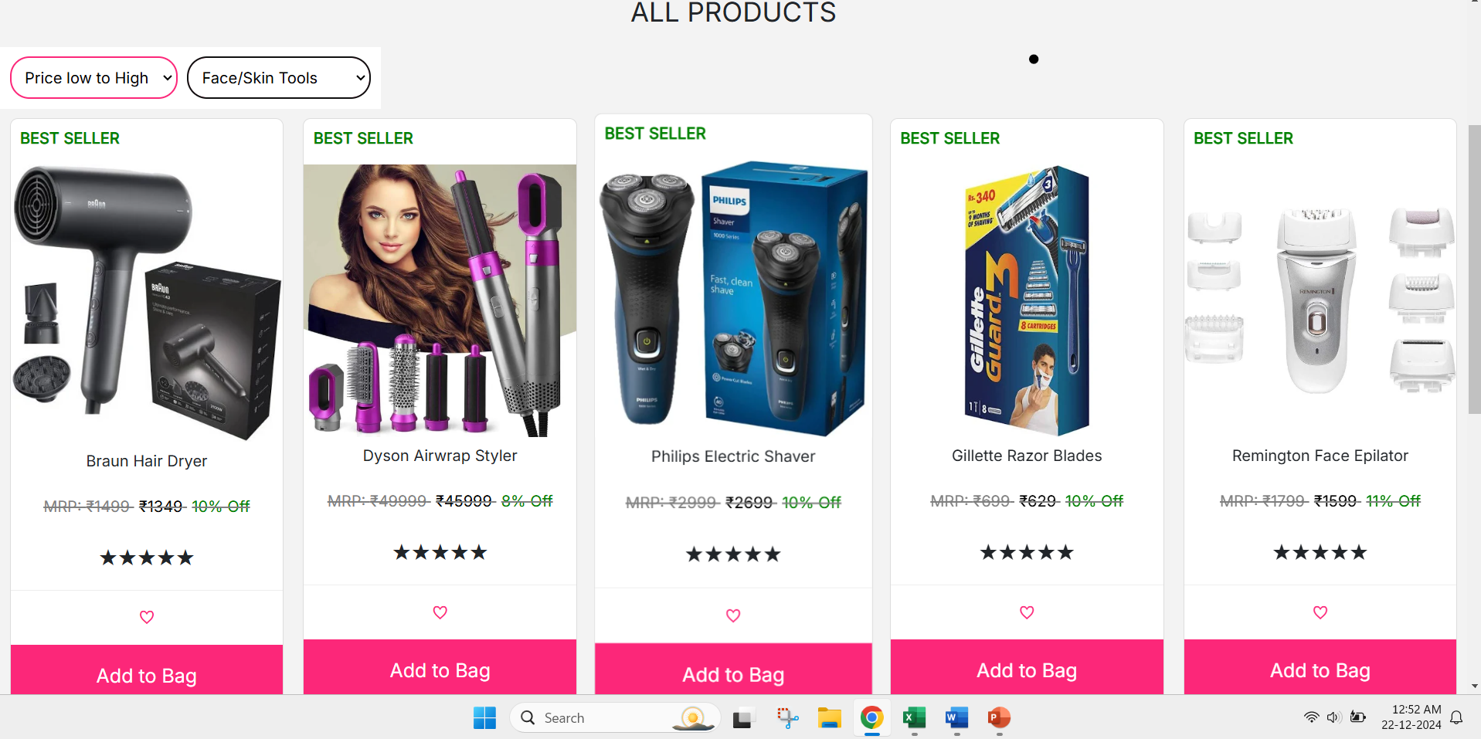

Bug18_Sorting filter is not working

Slide 20
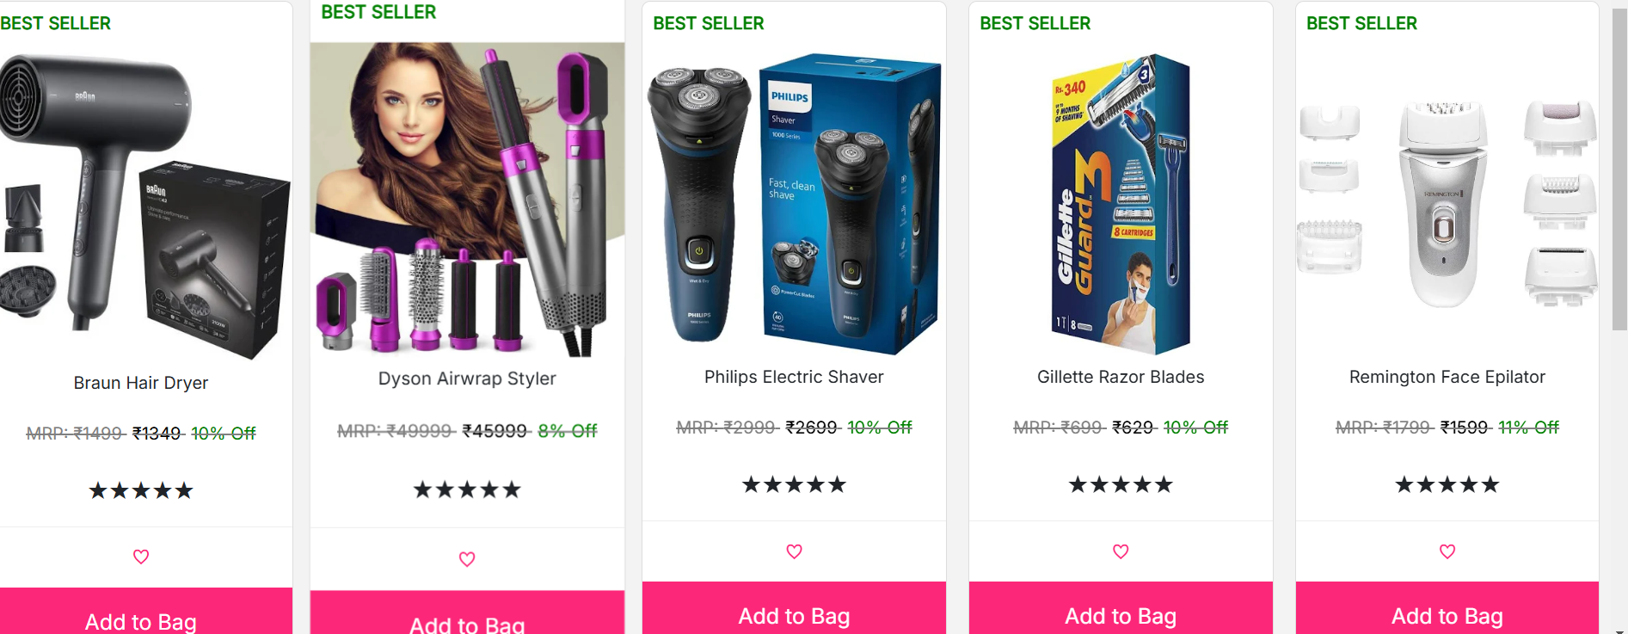

Bug19_Price is not displayed properly

Slide 21
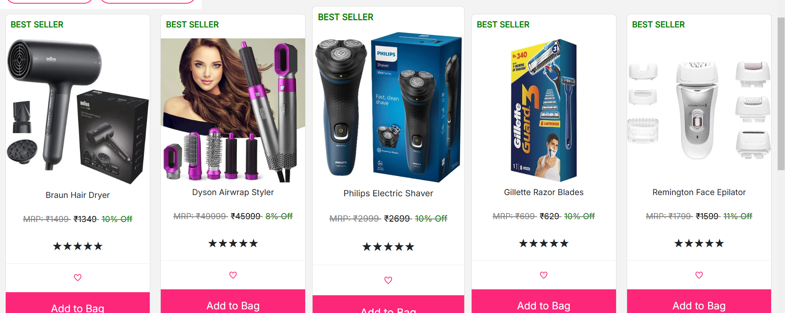
Bug_20:by click on product not disaplyed all info of product

Slide 22
Bug21_:-by category wise not show product

Slide 23
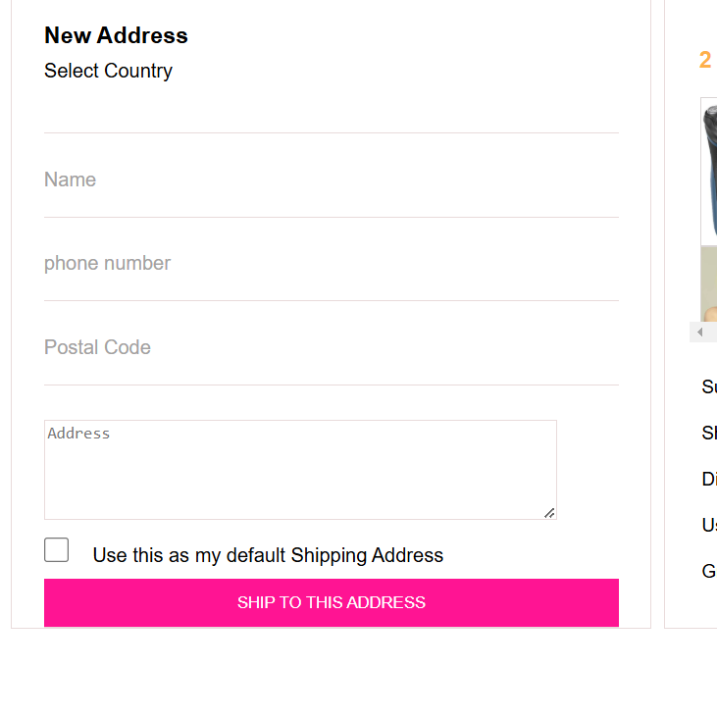
Bug_22:canot select the country dropdow

Slide 24
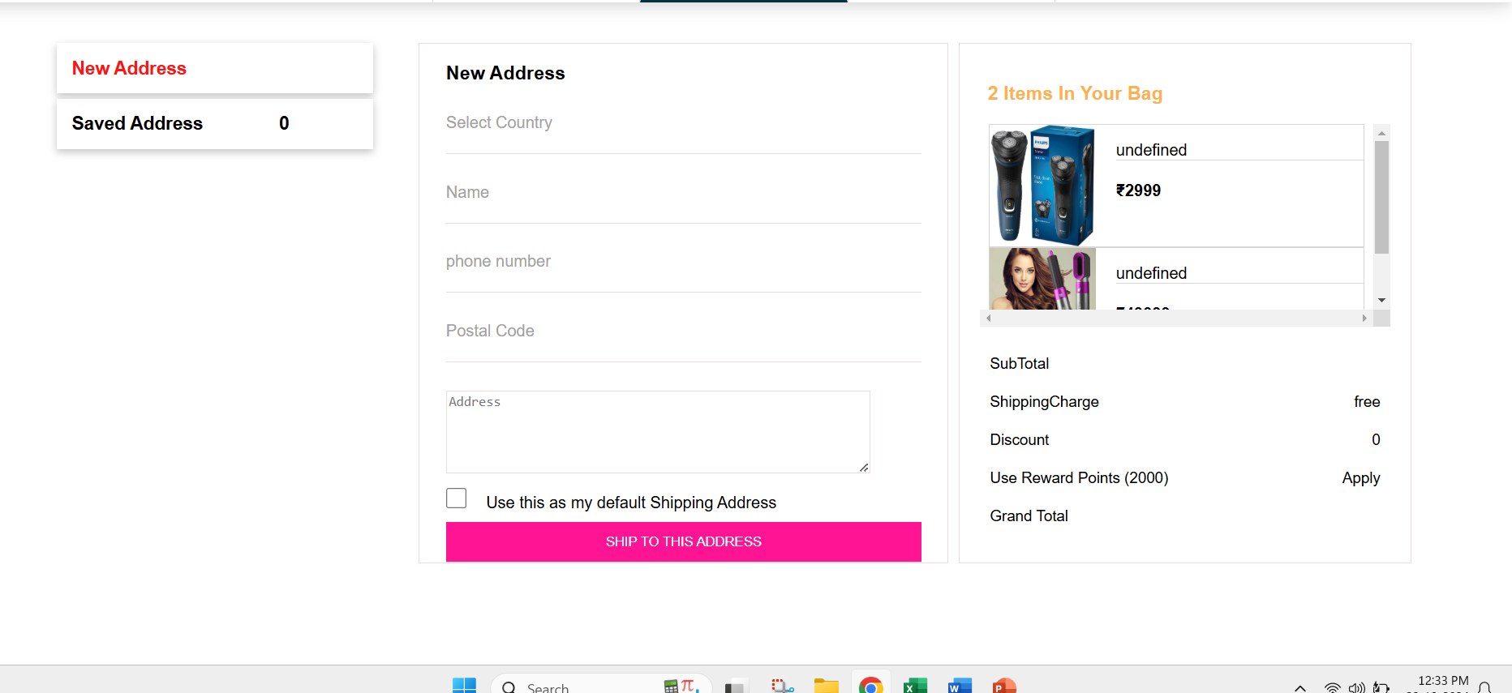
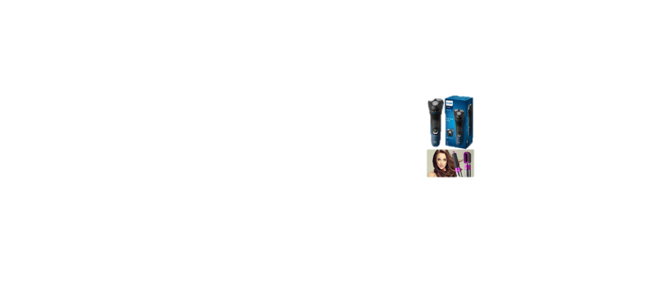
Bug23_ total price is not displayed in address tab

Slide 25
Bug_24:-Astrieak is not present in checkout page

Slide 26
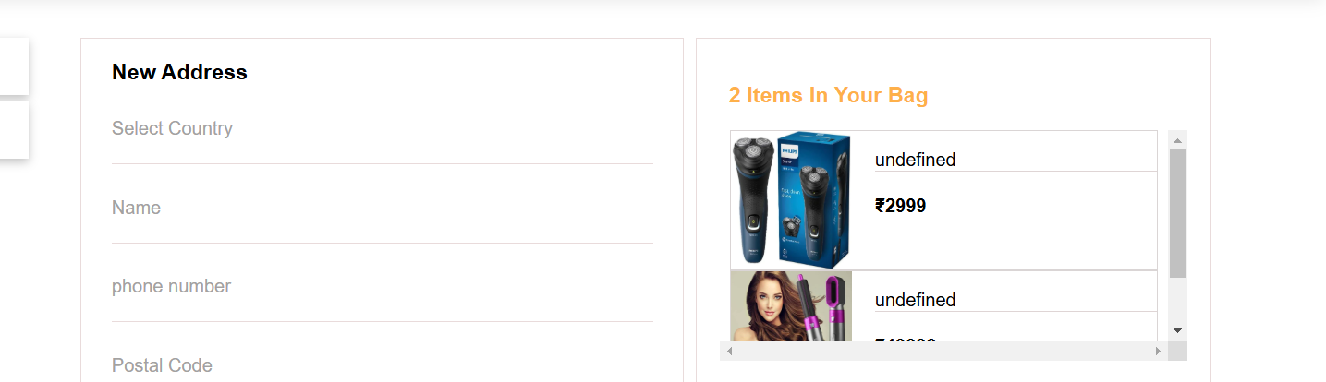

Bug_25:The product name is dispayed in checkout page

Slide 27
Bug_26:User is procced to next page without entering all details address , phoen number

